Slide 1

UrbanSense AI
Intelligent Urban Weather/Air Quality Prediction& Decision Support
Purpose:
Exasol AI Build Hackathon
Presented by:
VIT - CHENNAI
1. 23BRS1076 - Sandeep Ganesh
2. 23BRS1374 – Rithikha S
3. 23BRS1258 – Jeffrey Navin
4. 23BRS1423 – Swetha Arul

Slide 2
PROJECT OVERVIEW
Project Idea, Background & Significance
PROJECT IDEA
An urban decision-support system that combines heterogeneous city data to identify emerging problems, estimate their impact, and recommend suitable actions
SIGNIFICANCE
Weather Prediction: Anticipates upcoming weather conditions and potential risks
Air-Quality Intelligence: Identifies pollution levels and environmental risk patterns
Data-Driven Planning: Converts environmental data into understandable predictions and risk categories
Sustainable Cities: Supports better environmental awareness, preparedness and urban planning.
BACKGROUND
Rapid urbanization has increased the need for continuous monitoring of environmental conditions.
Weather conditions such as temperature, humidity, rainfall and wind directly influence air pollution levels.
DATA → INSIGHT → DECISION
Current Implementation
Weather-based prediction and air quality risk
assessment have been implemented
as the first component
02

Slide 3
PROBLEM DEFINITION
Problem Statement & Objectives
PROBLEM
Urban information is fragmented across multiple datasets, making it difficult to obtain a unified view of emerging city problems
Key Challenges
Different datasets have different formats, features and prediction targets.
OBJECTIVE
Build a system that can:
Process heterogeneous urban data
Identify emerging urban problems
Predict potential impact
Classify the level of risk
Recommend actionable interventions
`
Key Requirements
Integrate heterogeneous urban datasets
Process traffic, air quality, weather and incidents
Detect emerging problems
Predict potential impact
Produce interpretable 0–100 risk scores
Recommend actionable interventions
IDENTIFY
PREDICT
RECOMMEND

Slide 4
DATA & MACHINE LEARNING
Urban Data & Domain Models
Dataset
Example Features
ML Output
Machine Learning - Approach
Air Quality
Pollution-related information
Ex. PM2.5, PM10, NO2, SO2, CO, O3
Air Quality Risk: 0–100
XGBoost
Weather
Temperature, rainfall, humidity, wind, solar radiation
Weather Risk: 0–100
Random Forest
Traffic
Traffic volume, speed, congestion, delay
Traffic Risk: 0–100
Isolation Forest
Domain-specific models are used because each dataset
has different features and prediction targets.
04

Slide 5

SYSTEM DESIGN
Methodology & System Architecture
URBAN DATA INPUTS
Air Quality Data
Weather Data
Data Cleaning & Feature Engineering
Domain ML Models
Risk Scoring 0–100
EXASOL
Technical Stack
Exasol: Central analytical layer
SQL: processing and aggregation
Python/UDF: Exasol Python UDFs
NumPy
Scikit-learn
Emerging Problem Detection
Impact Prediction
AI Recommendation
CITY ACTION
05

Slide 6
DECISION LAYER
Results & AI-Decision Support
INTERPRETATION
URBAN CONDITIONS
EMERGING PROBLEM
POTENTIAL IMPACT
High congestion combined with poor air quality.
Increased travel delays and worsening local pollution.
Air Quality
82 / 100
Traffic
78 / 100
Weather
65 / 100
RECOMMENDED INTERVENTION
Prioritize traffic diversion and incident-response readiness in high-risk areas.
IDENTIFY → PREDICT → RECOMMEND
The AI layer converts numerical model outputs into actionable guidance.
06

Slide 7
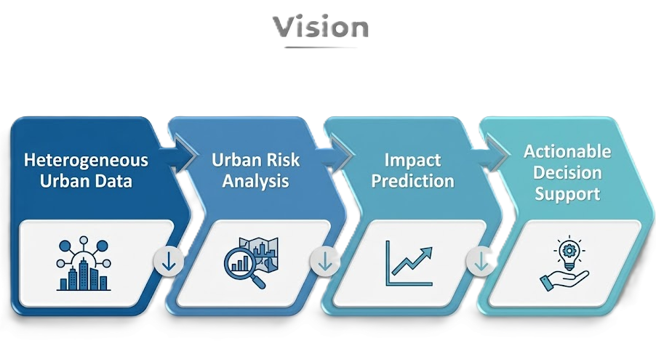
CONCLUSION
Expected Outcome & Team Responsibilities
EXPECTED OUTCOME
Conclusion
The current implementation establishes the weather-based prediction, air quality prediction and decision-support pipeline
The next stage expands this foundation into a unified urban-data system capable of analyzing multiple city conditions together
•
•
Unified view of heterogeneous urban data
•
Standardized 0–100 risk scores
•
•
Early detection of emerging problems
•
Actionable recommendations for city authorities
•
•
Prediction of potential impact
•
Predictive rather than purely reactive monitoring
From monitoring urban conditions to enabling timely decisions.
07

Slide 8
THANK YOU
Team Brainbots
VIT - CHENNAI

